Slide 1
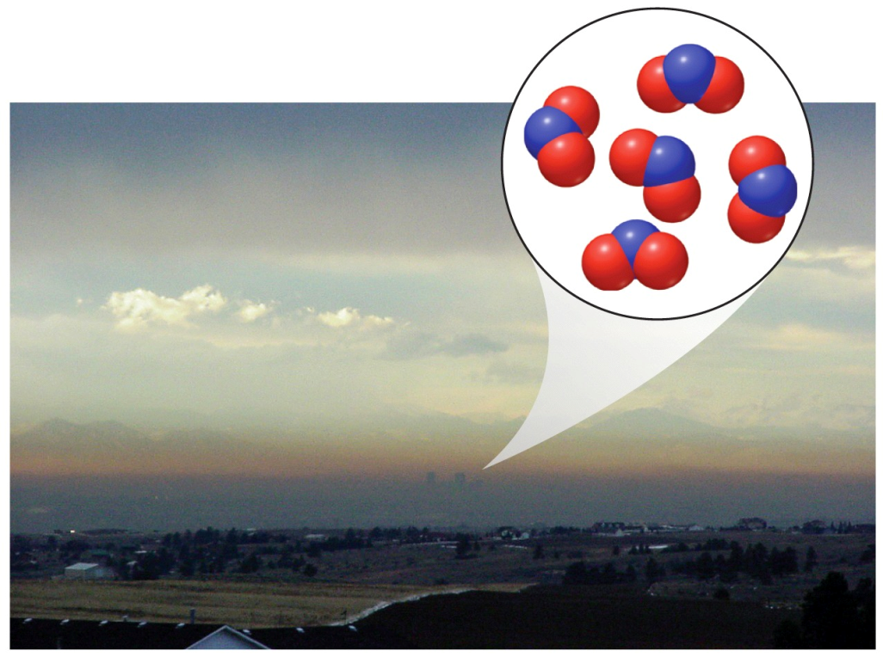
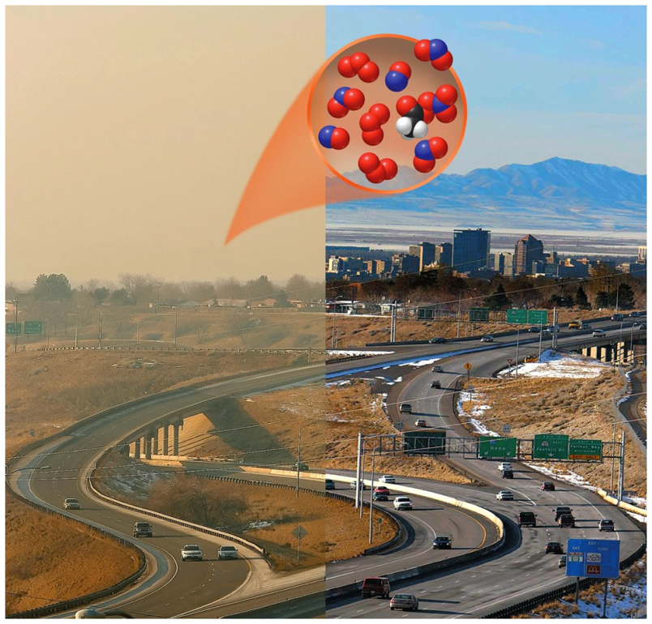
Reaction Rates
Chemical kinetics is the study of how fast reactions take place.
Some happen almost instantaneously, while others can take millions of years.
Increasing the rate of a reaction is important to many industrial processes.
Denver, CO
Salt Lake City, UT
Notes:
Urban Smog
A light snowfall and change in wind direction dramatically affect visibility and air quality over Salt Lake City, Utah, clearing the photochemical smog from the air. These photos were taken on January 28, 2007, at 4:15 pm (left) and January 31, 2007, at 3:53 pm (right). Note we said that diamonds thermodynamically decompose to graphite spontaneously. This process is thermodynamically spontaneous, but kinetically stable (take a long time). What does this speed of chemical processes mean? FIGURE 13.1
The orange-brown color of the air in this photo of Denver, Colorado, is due mostly to the presence of NO₂, one of many noxious compounds in photochemical smog.

Slide 2
Discuss!
If you start with 100g of carbon-14, there will be 50g of carbon-14 left after 5730 years.
Is this process spontaneous?
What are we measuring in this case?

Slide 3
Discuss!
If you start with 100g of carbon-14, there will be 50g of carbon-14 left after 5730 years.
Is this process spontaneous? yes
What are we measuring in this case?
A change in amount over a period of time
(this change in amount over time is “rate”)

Slide 4
Important Reactions in Smog
N₂(g) + O₂(g) → 2 NO(g) ΔH°= 180.6 kJ
2 NO(g) + O₂(g) → 2 NO₂(g) ΔH°= -114.2 kJ
Internal combustion engines provide heat energy needed for the reaction to occur. This is associated with industrial processes and cars. The EPA estimates 55% of NO_{x} are from anthropogenic sources. There are also some natural (but less significant) sources, such as lightning.
Note: Products of some reactions are reactants in other reactions.

Slide 5
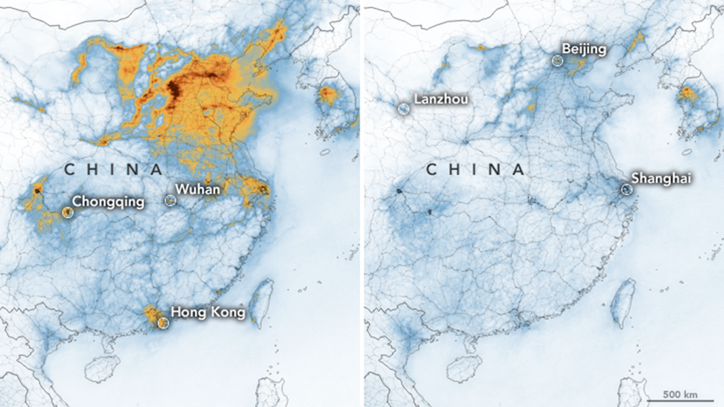
Nitrogen Dioxide Pollution in China
NASA and European Space Agency pollution monitoring satellites have detected significant decreases in nitrogen dioxide over China that researchers think is connected to the economic slowdown caused by the outbreak of coronavirus. The maps above show NO2 values across China from January 1-20, 2020, (before the quarantine) and February 10-25 (during the quarantine). (NASA Earth Observatory images by Joshua Stevens, using modified Copernicus Sentinel 5P data processed by the European Space Agency)

Slide 6
Discuss!
The air is roughly 80% N₂ and 20% O₂.
N₂(g) + O₂(g) → 2 NO(g) ΔH°= 180.6 kJ
Why doesn’t NO form all the time?
For this reaction, is solar power (sunlight) enough to power it to a significant degree?

Slide 7
Discuss!
The air is roughly 80% N₂ and 20% O₂.
N₂(g) + O₂(g) → 2 NO(g) ΔH°= 180.6 kJ
Why doesn’t NO form all the time? Needs a lot of heat to get it to happen!
For this reaction, is solar power (sunlight) enough to power it to a significant degree? No – we can tell since it is not found in high amounts under natural circumstances.

Slide 8
Important Reactions in Smog
NO₂(g) NO(g) + O(g)
O₂(g) + O(g) → O₃(g)
O(g) + H₂O(g) → 2 OH(g)
Note: Products of some reactions are reactants in other reactions. This can become fairly complicated.
Photochemical smog involves sunlight as an energy source for some reactions.

Slide 9
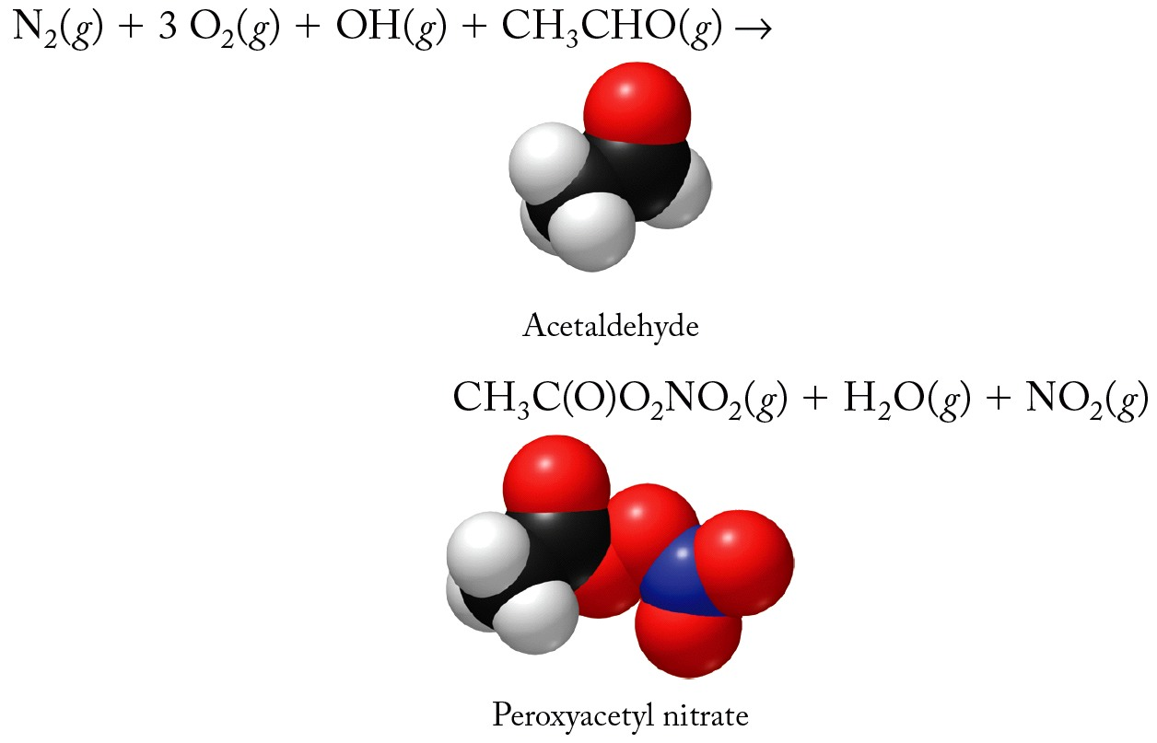
Variations of Smog Composition
acetaldehyde (common VOC – volatile organic compound) makes PAN (this product that is highly irritating to eyes, throat, nose – respiration)

Slide 10
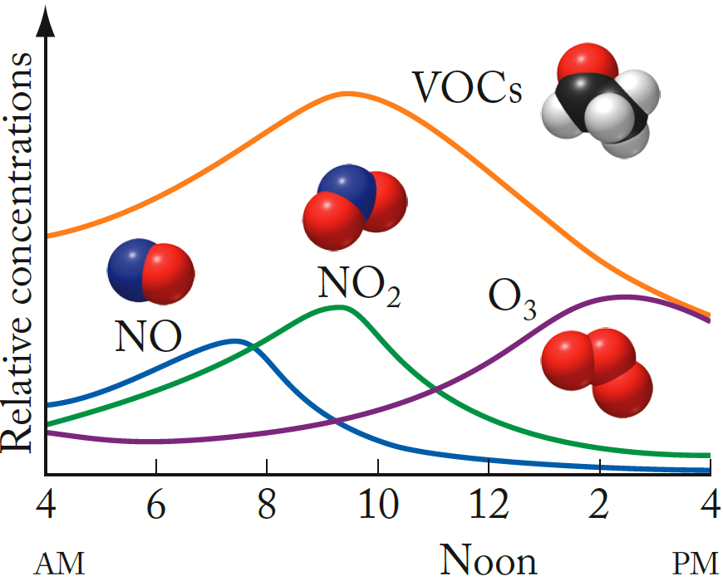
Daily Variations - Smog Composition
Photodecomposition of NO₂ leads to high levels of O₃ in the afternoon. Extra sunlight in summer leads to seasonal extra ozone formation.

Slide 11
Discuss!
Are the concentrations of gases such as NO and O₃ constant values?
Are the changes in concentration over time constant values?
Why might this be useful to know?

Slide 12
Discuss!
Are the concentrations of gases such as NO and O₃ constant values? No. Not a straight line.
Are the changes in concentration over time constant values?
No – they irregularly curve up and down because of a series of complex factors.
Why might this be useful to know? We breathe! Might influence decisions on when to drive, or what to drive.

Slide 13
Collision Theory of Chemical Reactions
14.2
Most reactions happen faster at higher temperature.
Chemical reactions generally occur as a result of collisions between reacting molecules.
According to collision theory of chemical kinetics, the reaction rate is directly proportional to the number of molecular collisions per second:

Slide 14
Discuss!
If you have a reaction that you want to speed up, what are some things you can try?
A) finely divide any solids
B) put all reactants in the gas phase
C) heat it up
D) increase the concentrations of reactants
E) all of these
Notes:
Doc cam E

Slide 15
Discuss!
If you have a reaction that you want to speed up, what are some things you can try?
A) finely divide any solids
B) put all reactants in the gas phase
C) heat it up
D) increase the concentrations of reactants
E) all of these
Notes:
Doc cam E

